Slide 1

Data manipulation commands including INSERT, UPDATE and DELETE
Database Management System | SQL and Advanced Query Formulation
Course: Database Management System (DBMS) | Chapter: SQL and Advanced Query Formulation | Program: Bachelor of Engineering
DISCOVER · LEARN · EMPOWER
Notes:
Welcome students to this lecture on Data Manipulation Commands. We are focusing specifically on how to modify data within our relational schemas. Remember, our motto at Chandigarh University is to Discover, Learn, and Empower through technical mastery. Today we will move from theory to practical application of SQL commands.

Slide 2
Course Outcomes
SLIDE 2 / 14
Course Outcome
CO | BT LEVEL | DESCRIPTION
CO1 | BT2 | Explain database architecture, relational model concepts and formal query language foundations including relational algebra and relational calculus.
CO2 | BT3 | Apply relational algebra, relational calculus and SQL constructs to formulate correct and efficient database queries.
CO3 | BT4 | Analyze functional dependencies and design normalized relational schemas up to 5NF ensuring lossless join and dependency preservation.
CO4 | BT4 | Analyze transaction schedules and concurrency control mechanisms to determine serializability, recoverability and correctness.
CO5 | BT5 | Evaluate storage structures, indexing strategies and query optimization techniques for performance, scalability and reliability.
Chandigarh University
2 / 14
Notes:
This lecture directly supports our Course Outcomes. CO3 ensures that when we insert or update data, we maintain the integrity of our normalized schemas. CO4 is critical because every update or delete is a transaction that must be serializable and recoverable. We will see how these commands impact the overall system correctness.

Slide 3
Learning Objectives
SLIDE 3 / 14
Learning Outcomes
1
Analyze the syntax and execution flow of the INSERT command for data entry.
2
Evaluate the impact of UPDATE statements on existing relational data rows.
3
Differentiate between DELETE and TRUNCATE operations regarding transaction logs.
4
Apply WHERE clauses to target specific records for modification safely.
5
Assess the risks of accidental data loss during manipulation operations.
Chandigarh University
3 / 14
Notes:
By the end of this session, you will be able to analyze how these commands alter the database state. We will evaluate the specific syntax required for each operation. You will learn to differentiate between deleting a single row and clearing an entire table. Finally, we will assess the risks involved in these powerful operations.

Slide 4
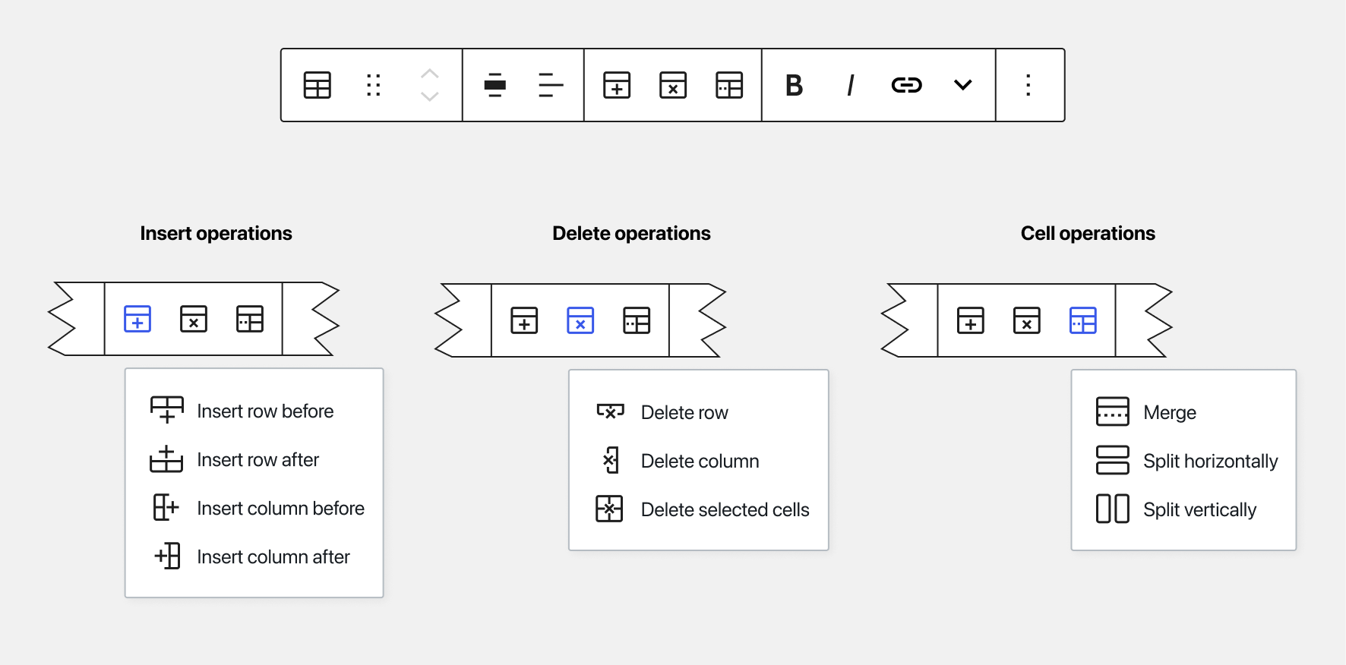
Lecture
SLIDE 4 / 14
The INSERT Command Fundamentals
1
INSERT adds new rows to a specified table without modifying existing data.
2
Syntax requires specifying the table name and a list of column values.
3
The command must provide values for all NOT NULL columns explicitly.
4
Data types in the value list must match the column definitions strictly.
5
Multiple rows can be inserted in a single statement for efficiency.
6
Primary key constraints prevent duplicate entries for unique identifier columns.
Table Block] Improve existing table icons · Issue #32556 · WordPress/gutenberg
Chandigarh University
4 / 14
Notes:
The INSERT command is the primary way to populate a database. Think of it as adding a new student record to a class roster. You must provide values for every column that does not allow nulls. If you try to insert a string into a number column, the database will reject the operation immediately.

Slide 5
Lecture
SLIDE 5 / 14
INSERT Syntax and Worked Example
BASIC SYNTAX
INSERT INTO table_name (col1, col2) VALUES (val1, val2).
EXAMPLE
INSERT INTO Students (ID, Name, Age) VALUES (101, 'Rahul', 20).
• The value list order must correspond exactly to the column list order.
• String values must be enclosed in single quotes to distinguish from identifiers.
• Numeric values do not require quotes and are stored in binary format.
• Omitting columns allows the database to use default values automatically.
Chandigarh University
5 / 14
Notes:
Let's look at a concrete example. We are inserting a student with ID 101 named Rahul. Notice that 'Rahul' is in single quotes because it is text. If we omit the Age column and it has a default of 18, the system fills it automatically. This flexibility helps reduce the amount of code we need to write.

Slide 6
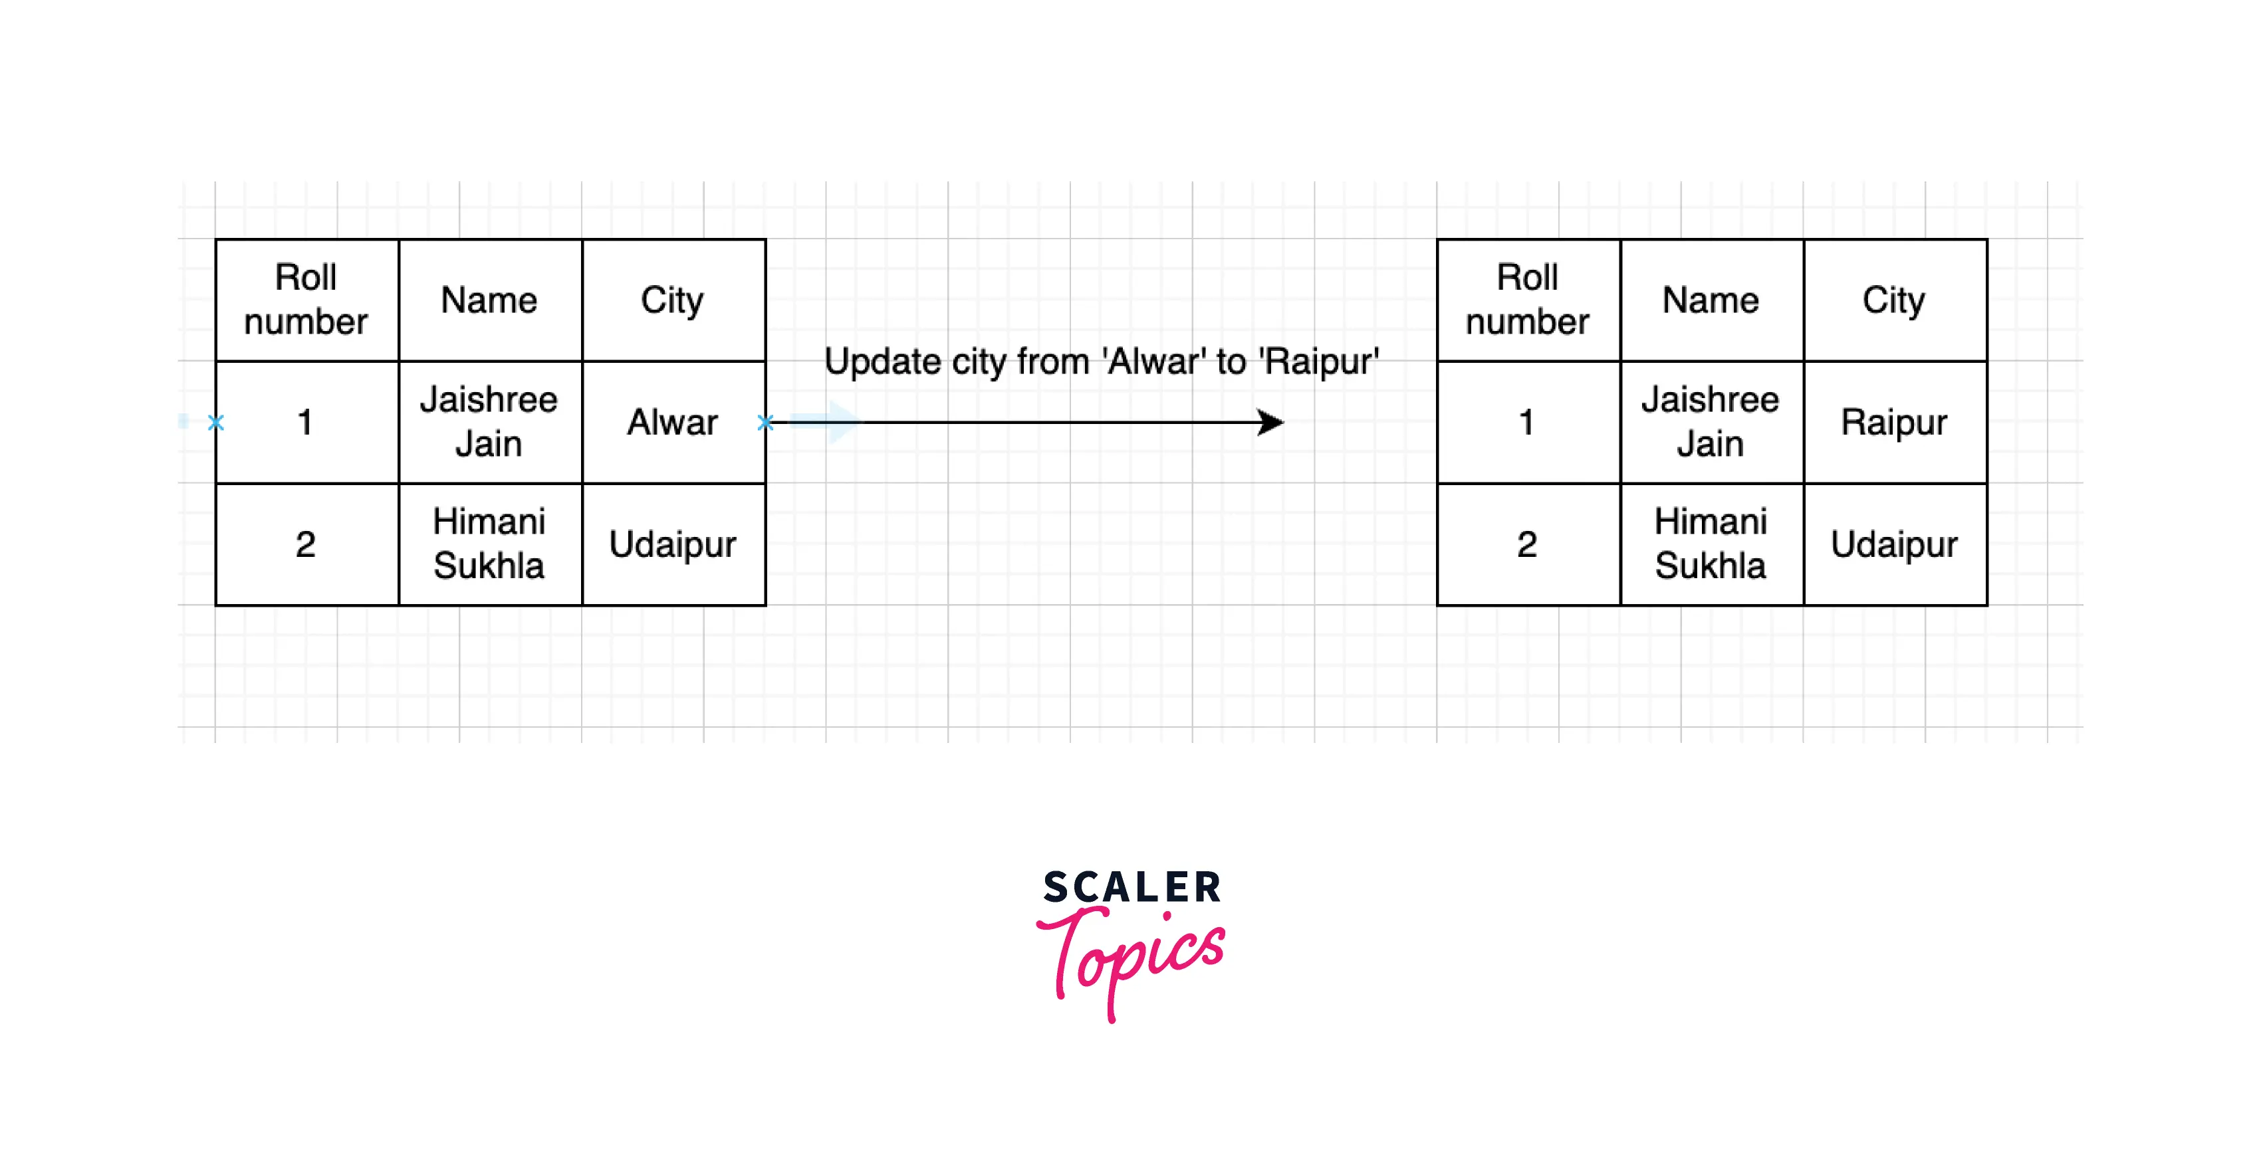
Lecture
SLIDE 6 / 14
The UPDATE Command Mechanics
1
UPDATE modifies existing data values in one or more rows of a table.
2
The SET clause specifies the column name and the new value to assign.
3
A WHERE clause is essential to target specific rows for modification.
4
Omitting the WHERE clause updates every single row in the table.
5
The command checks constraints before applying changes to ensure validity.
6
Multiple columns can be updated simultaneously in a single statement.
Source: scaler.com
Chandigarh University
6 / 14
Notes:
The UPDATE command is like editing a student's grade in the roster. You must use the SET clause to define the new value. Crucially, you must include a WHERE clause to avoid changing every student's grade. Without it, you accidentally update the entire table, which is a common and costly error.

Slide 7
Lecture
SLIDE 7 / 14
UPDATE Syntax and Worked Example
GOVERNING EQUATION
Basic syntax: UPDATE table_name SET col1 = val1 WHERE condition
EXAMPLE
UPDATE Students SET Age = 21 WHERE ID = 101.
EXAMPLE
UPDATE Students SET Age = Age + 1 WHERE ID = 101.
• The condition must evaluate to true for the row to be modified.
• Arithmetic operations can be used in the SET clause for calculations.
• The command returns the count of rows affected by the operation.
Chandigarh University
7 / 14
Notes:
Here we update Rahul's age to 21. The WHERE clause ensures only ID 101 is changed. We can also perform arithmetic, like incrementing the age by one year. The database will return a message saying '1 row affected'. If the ID did not exist, it would say '0 rows affected'.

Slide 8
Lecture
SLIDE 8 / 14
The DELETE Command Mechanics
1
DELETE removes one or more rows from a table permanently.
2
The WHERE clause specifies which rows meet the deletion criteria.
3
Omitting the WHERE clause deletes all rows but keeps the table structure.
4
Deleted data is removed from the data pages and marked as free space.
5
The operation is logged in the transaction log for potential recovery.
6
Foreign key constraints may prevent deletion if related records exist.
Chandigarh University
8 / 14
Notes:
The DELETE command removes data permanently, unlike a logical flag. It is crucial to understand that the table structure remains intact. If you have foreign keys, the database might block the deletion to preserve referential integrity. Always verify your WHERE clause before executing to prevent accidental data loss.

Slide 9
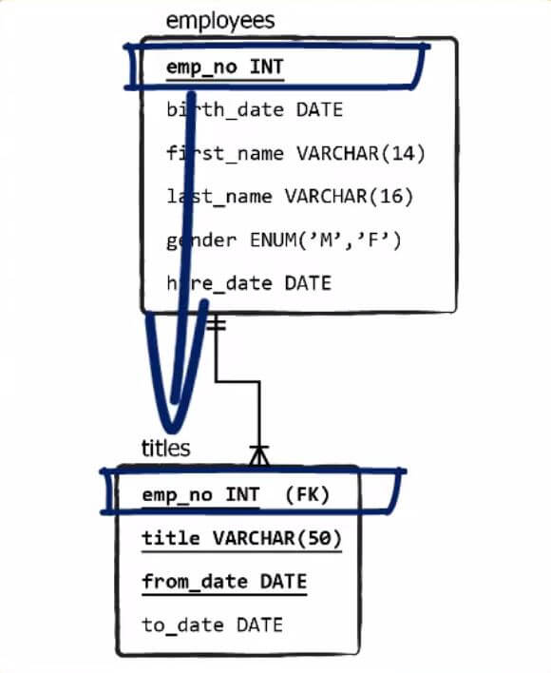
Lecture
SLIDE 9 / 14
DELETE Syntax and Worked Example
GOVERNING EQUATION
Example: DELETE FROM Students WHERE ID = 101
BASIC SYNTAX
DELETE FROM table_name WHERE condition.
EXAMPLE
DELETE FROM Students WHERE Age < 18.
• The condition must uniquely identify the row to be removed.
• Multiple rows can be deleted if they all satisfy the condition.
• The command returns the number of rows successfully deleted.
Source: 365datascience.com
Chandigarh University
9 / 14
Notes:
We delete the student with ID 101. If we wanted to remove all students under 18, we would use the second example. The database will return the count of rows removed. This is a destructive operation, so it is often wrapped in a transaction to allow rollback if an error occurs.

Slide 10
Lecture
SLIDE 10 / 14
Common Pitfalls in Data Manipulation
1
Forgetting the WHERE clause in UPDATE or DELETE causes mass data loss.
2
Using incorrect data types leads to implicit conversion errors or failures.
3
Violating NOT NULL constraints prevents insertion of incomplete records.
4
Ignoring foreign key constraints causes referential integrity violations.
5
Executing commands without a transaction allows partial updates to persist.
6
Case sensitivity in string comparisons can lead to unexpected results.
Chandigarh University
10 / 14
Notes:
The most common pitfall is forgetting the WHERE clause. This turns a targeted update into a table-wide wipe. Another issue is data type mismatches, like trying to insert text into a date column. Always test your queries on a small subset or use a transaction to ensure safety before committing changes.

Slide 11
Lecture
SLIDE 11 / 14
Transaction Safety and Rollback
1
Data manipulation commands are part of a transaction unit of work.
2
A transaction ensures all changes succeed or none are applied at all.
3
The ROLLBACK command undoes all changes made since the last commit.
4
COMMIT makes the changes permanent and visible to other users.
5
Concurrency control mechanisms prevent conflicting updates from the same row.
6
Isolation levels determine how visible uncommitted changes are to others.
Chandigarh University
11 / 14
Notes:
Every INSERT, UPDATE, or DELETE is a transaction. If a power failure occurs mid-operation, the database uses the transaction log to roll back changes. This ensures the database remains consistent. We use COMMIT to save changes permanently and ROLLBACK to undo them if something goes wrong. This is vital for maintaining data integrity.

Slide 12
Lecture
SLIDE 12 / 14
Impact on Normalized Schemas
1
INSERT operations must respect the functional dependencies of the schema.
2
UPDATE operations must not violate the normalization rules of the table.
3
Deleting a parent row may require cascading deletes in normalized designs.
4
Data manipulation must preserve the lossless join property of the schema.
5
Normalization reduces redundancy but requires careful handling of updates.
6
Proper indexing speeds up the search for rows during UPDATE and DELETE.
Chandigarh University
12 / 14
Notes:
Remember CO3, which focuses on normalized schemas. When we insert data, we must ensure we are not creating anomalies. Updating a non-key attribute in a normalized table is safer than in a denormalized one. However, we must handle cascading deletes carefully to maintain referential integrity across related tables.

Slide 13
Lecture
SLIDE 13 / 14
Key Takeaways
1
INSERT adds new rows; UPDATE modifies existing data; DELETE removes rows.
2
Always use a WHERE clause to target specific rows in UPDATE and DELETE.
3
Data types must match column definitions to prevent insertion errors.
4
Wrap manipulation commands in transactions to ensure recoverability and safety.
5
Respect foreign key constraints to maintain referential integrity in schemas.
Chandigarh University
13 / 14
Notes:
To summarize, remember the distinct purpose of each command. The most critical rule is to always verify your WHERE clause. Treat every modification as a transaction to protect your data. Finally, respect the constraints of your normalized schema to ensure the database remains consistent and reliable.

Slide 14
Lecture
SLIDE 14 / 14
References
1
Fundamentals of Database Systems — Ramez Elmasri & Shamkant B. Navathe
2
Database System Concepts — Silberschatz, Korth & Sudarshan
3
Database Management Systems — Raghu Ramakrishnan & Johannes Gehrke
4
Oracle/MySQL Documentation — Oracle
Chandigarh University
14 / 14
Notes:
These are the standard texts we recommend for further study. Elmasri and Navathe provide a deep theoretical foundation. Silberschatz offers excellent practical examples. Ramakrishnan covers the implementation details, and Oracle documentation provides specific syntax for the database systems you will use. Please refer to these for advanced topics.

